Slide 1


ZEWAIL CITY
UNIVERSTY OF SCIENCE AND TECHNOLOGY
Analyzing Diabates Dataset
Amr Yasser,
Omar Hazem
Mohamed Mourad,
Youssef Mohammad,
Hady Emad
DSAI 307: Statistical Inference

Slide 2

Agenda
01 Introduction
05 Hypothesis Testing
02 Data Quality
06 Simulation Study
03 Exploratory Data Analysis (EDA)
07 Conclusion
04 Key Questions & Risk Profiles

Slide 3
01 Introduction
The primary goal is to analyze:
Diabetes contributing factors
Health Trends
Provided data:
Adapted from governmental sources
Sized 750+ rows X 9 features

Slide 4

02 Data Quality
Unlogical zeros handling → nan
Duplicates check
Mean Imputation

Slide 5
03 EDA
Insights
Imbalance (fig.1)
Weak correlation between glucose and BMI
Direct correlation between age and glucose (fig.2)

Slide 6
03 EDA
Insights
Glucose in diabetic patients is always higher (fig.2)
BMI is almost normally distributed (fig.3)
DPF has outliers (fig.4)

Slide 7
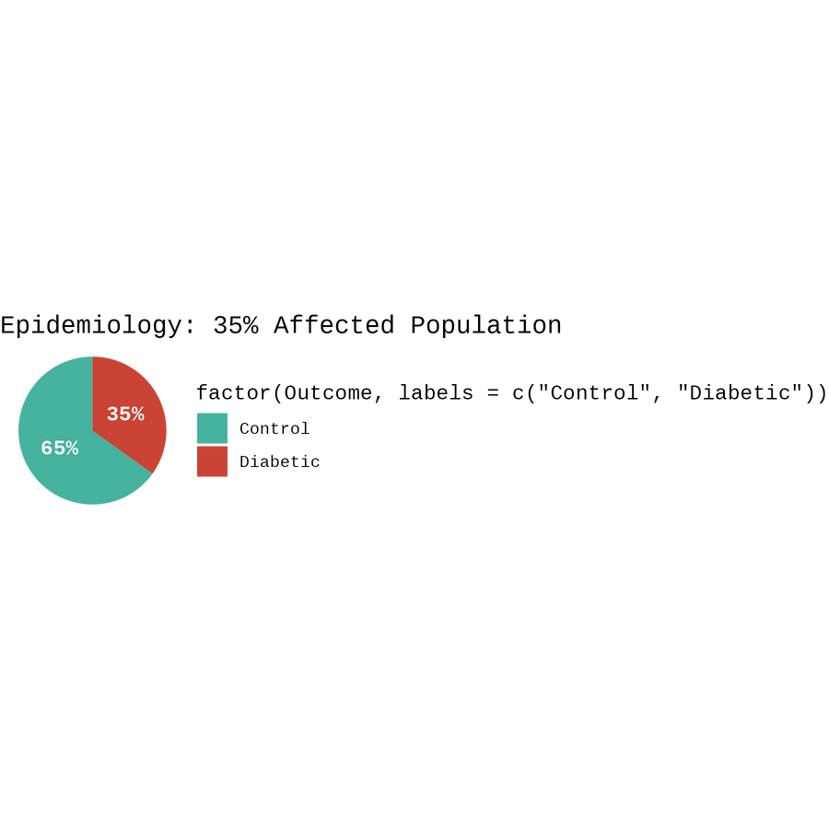
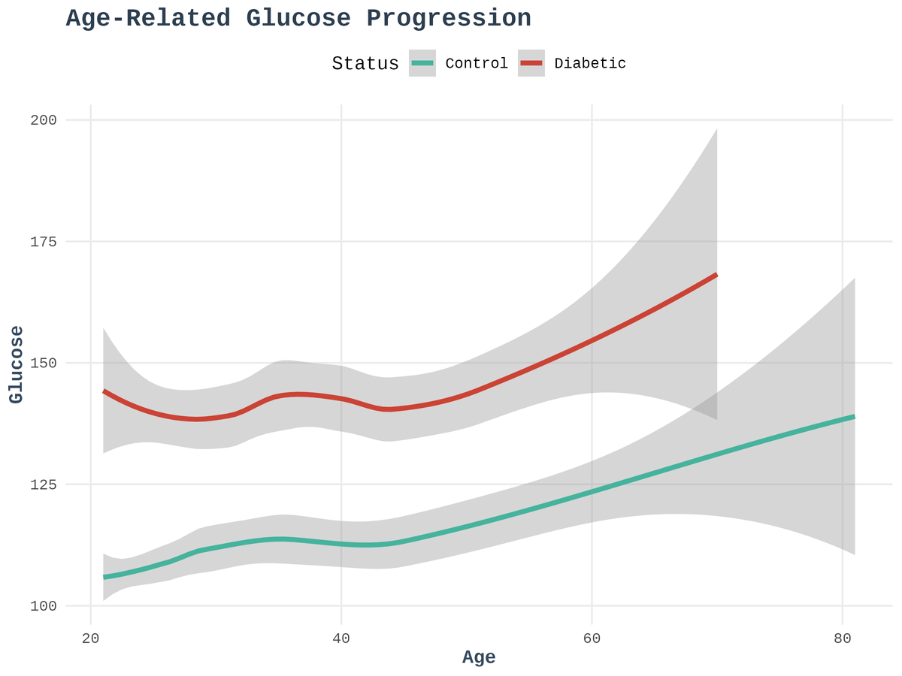
fig.1
fig.2

Slide 8

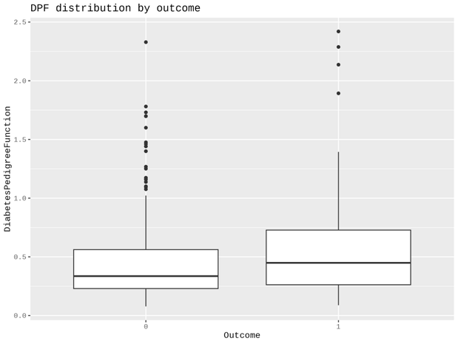
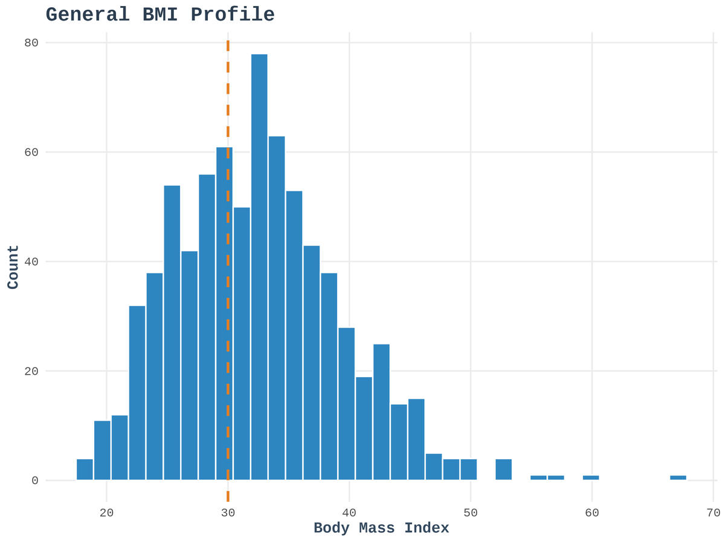
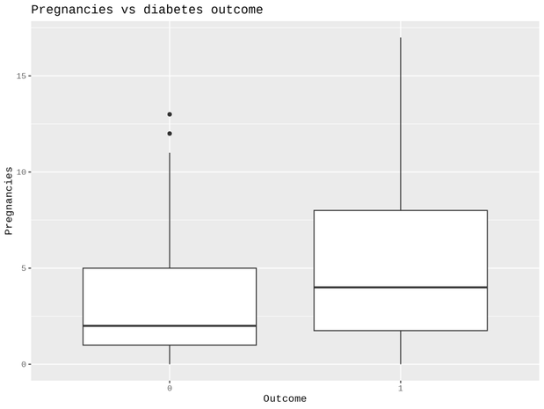
fig.4
fig.3
fig.5

Slide 9

04 Key Questions
Q1. Diabetes-Glucose Direct Correlation
Yes. Visualized in fig.2 (Task 1), glucose levels are higher in diabetic group. (fig.6)
Q2. Glucose-BMI Direct Correlation
A positive correlation exists at ~23%. (fig. 8)
Q3. Pregnancies-Diabetes Risk Correlation
As shown in Task 8, the incidence of diabetes increases steadily with the number of pregnancies recorded. (fig.7)

Slide 10
04 Key Questions
Q4. Age vs Insulin and Glucose
Glucose shows a strong upward trend with age. (fig.10)
Insulin shows more peak dynamics in middle-aged groups.
Q5. Risk Profiles
Healthy:
Age < 30, Glucose < 110, BMI < 30.
High Risk:
Age > 35, Glucose > 140, BMI > 34.

Slide 11
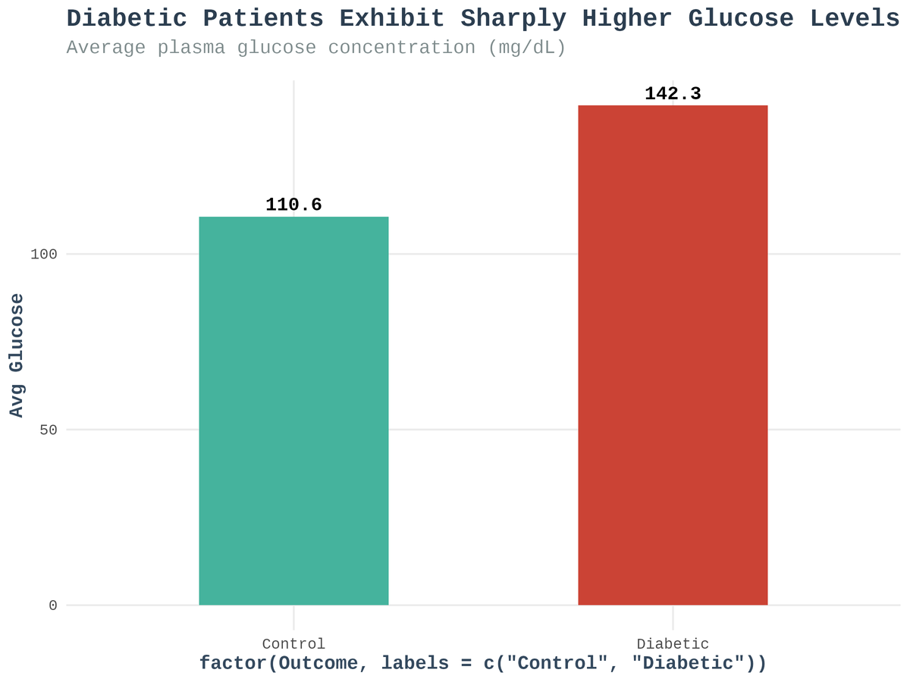
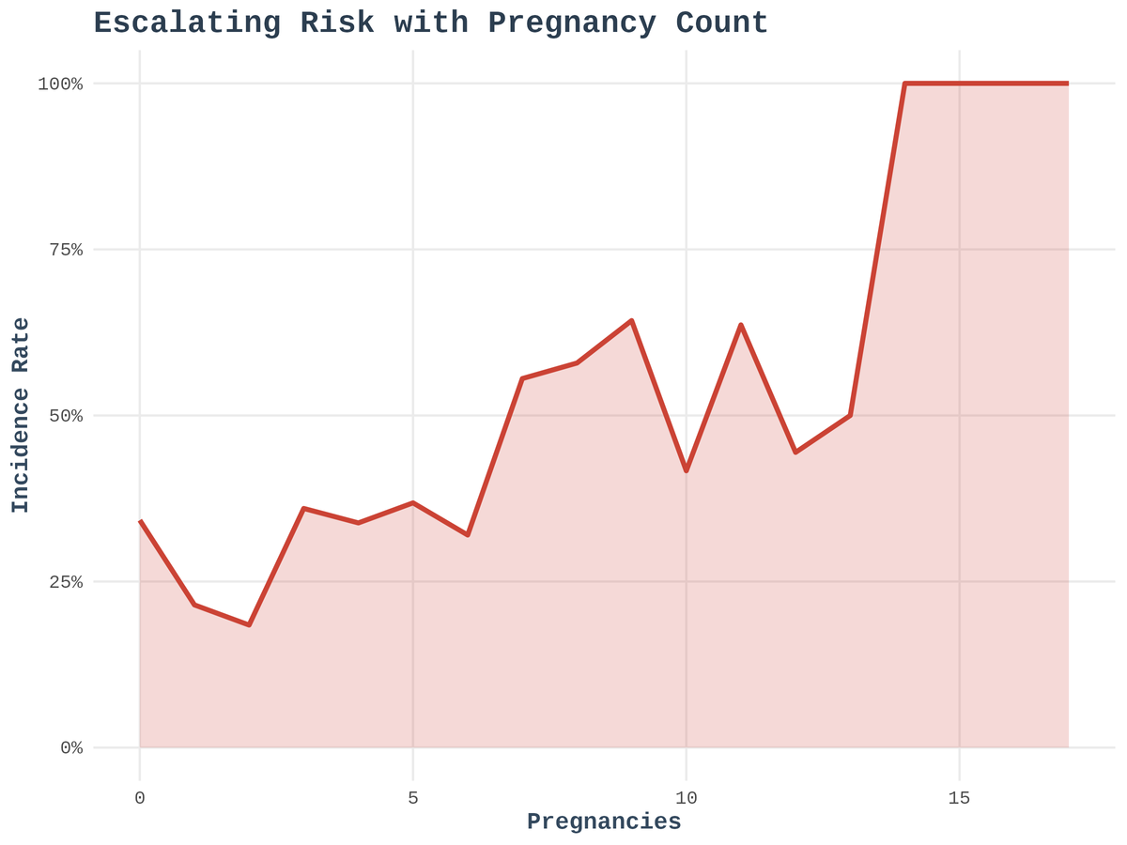
fig.6
fig.7

Slide 12
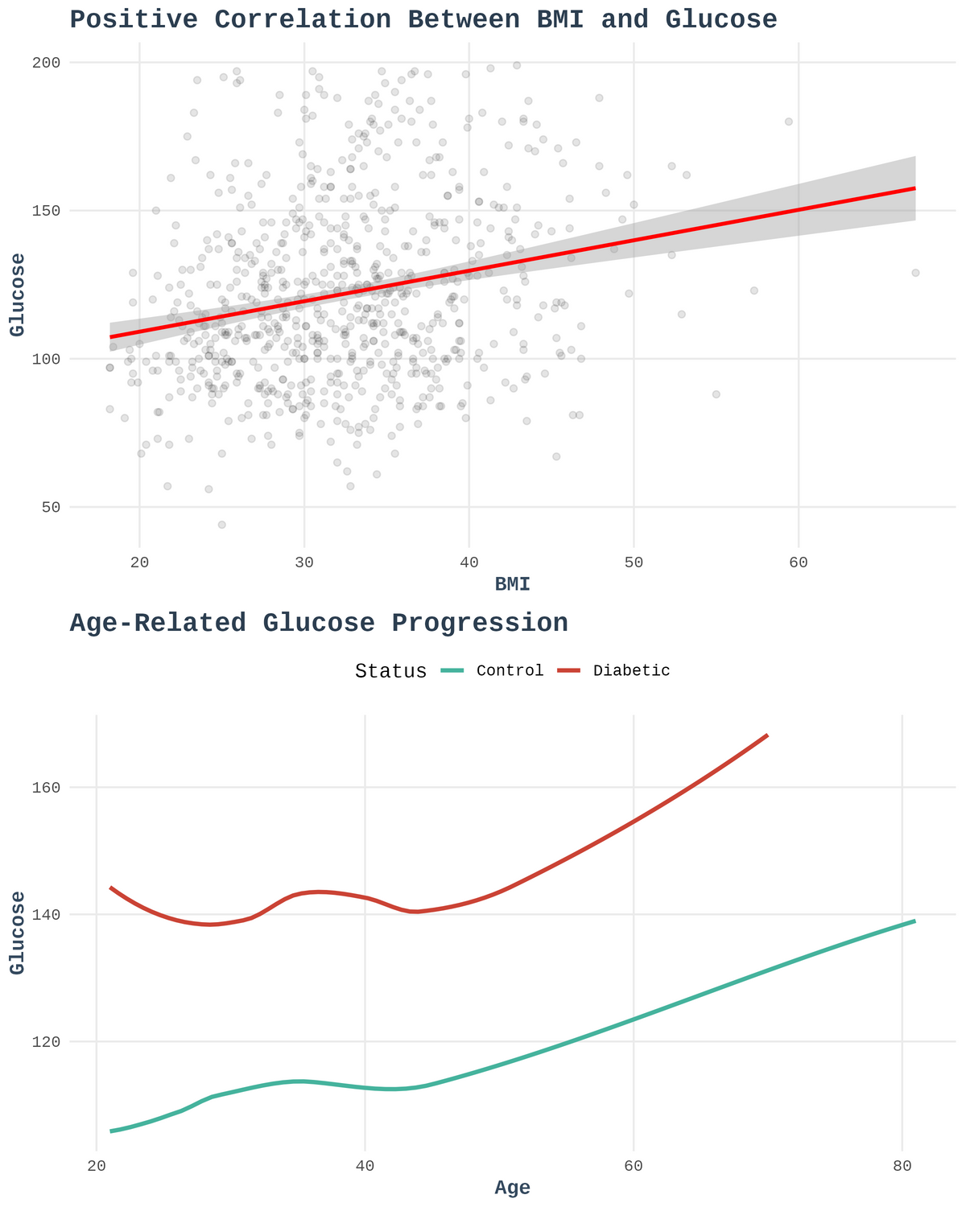


fig.8
fig.9

Slide 13
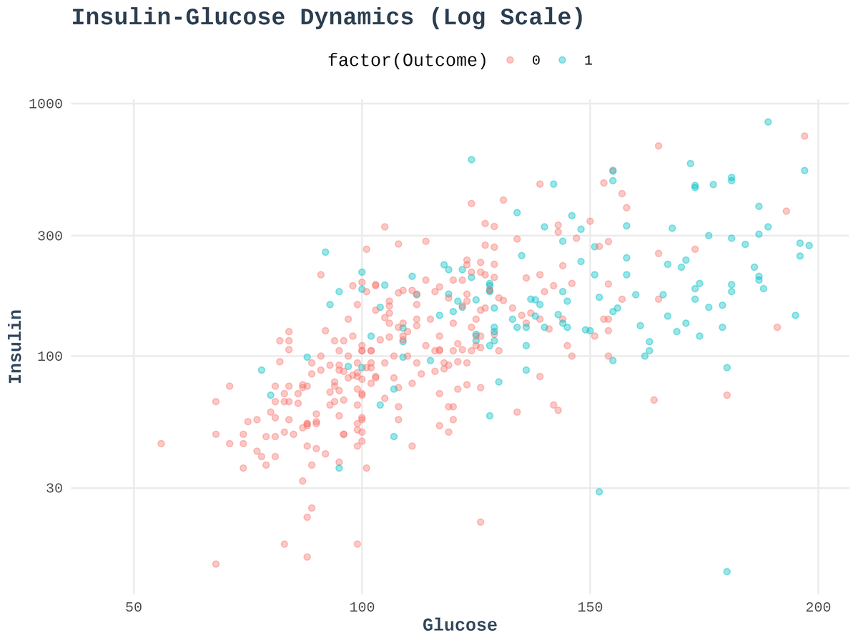
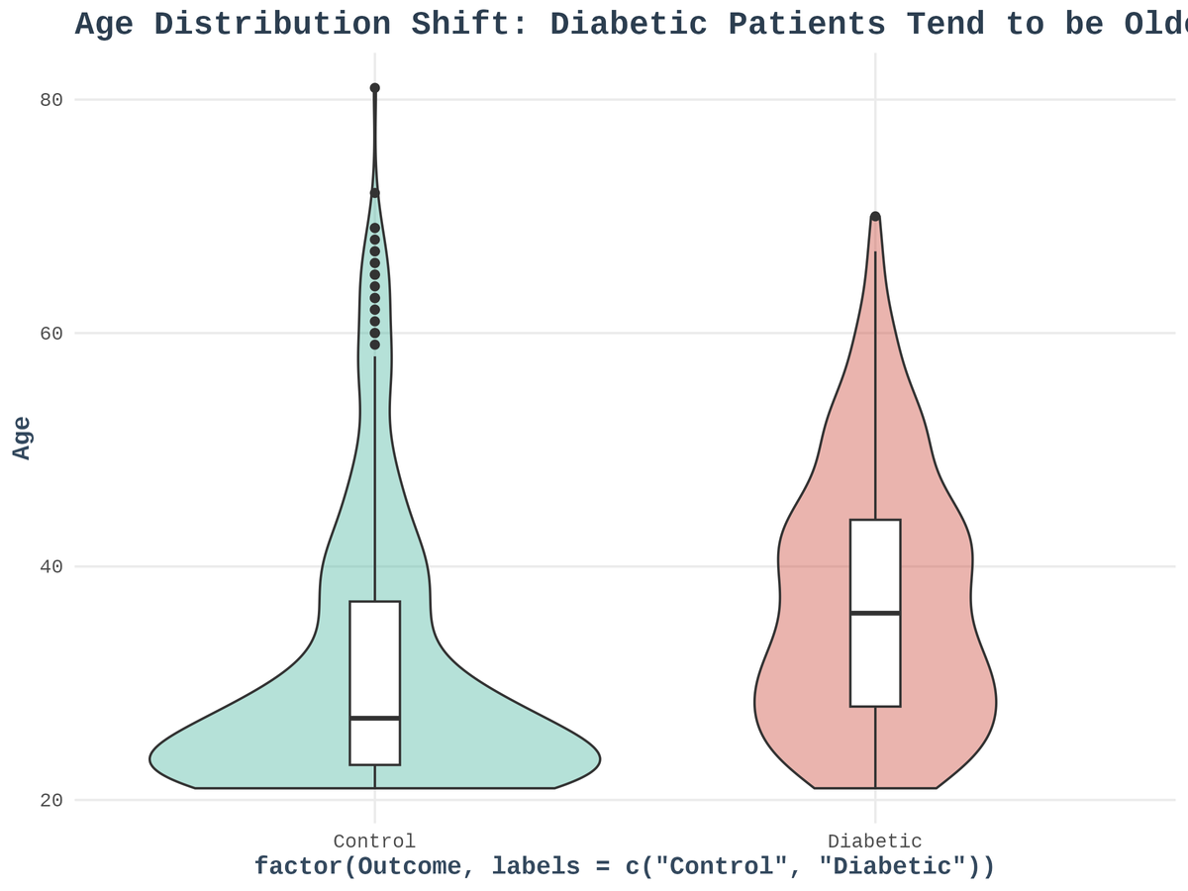
fig.10
fig.11

Slide 14

04 Key Questions
Additional +5 Qs are present in the report
Supported with visualizations and answered
Many more at:
Full Report and GitHub Repository

Slide 15

05 Hypothesis Testing
Claim 1:
Glucose Differences across groups: diabetic and non-diabetic patients
Hypotheses:
H0 (Null): Mean glucose is equal across groups.
H1 (Alternative): Mean glucose is not equal across groups.
Results: Using Two-sample T-Test
P-value < 0.05 (specifically ~0.0).
Rejects null hypothesis

Slide 16
05 Hypothesis Testing
Claim 2:
BMI Differences across groups: diabetic and non-diabetic patients
Hypotheses:
H0 (Null): Mean BMI is equal across groups.
H1 (Alternative): Mean BMI is not equal across groups.
Results: Using Two-sample T-Test
P-value < 0.05 (specifically ~10^ -16).
Rejects null hypothesis

Slide 17
06 Simulation Study
Selected BMI (normally distributed)
population mean = ~ 32.5
Applied 3 experiments
Experiment A: n = 15
Generated 25 random samples
Confidence interval of 95%
Results:
Successfully captured the true population mean.

Slide 18
06 Simulation Study
Experiment B: n = 100
Generated 25 random samples
Observed: decreased confidence width
Results:
led to narrower, more precise intervals.
reducing uncertainty.

Slide 19
06 Simulation Study
Experiment C: n = 10
Generated 20 random samples
Results:
Wider Intervals.
More variable accuracy in containing the true mean.

Slide 20

Thank You !

